Slide 1
Swing User Interfaces
Appendix C
Sun Certified Java Programmer Workshop

Slide 2
Contents
Introduction to Swing
A worked example
Demo project: DemoSwingUI

Slide 3
1. Introduction to Swing
What is Swing?
Swing features
Design patterns used in Swing

Slide 4
What is Swing?
Swing is a standard (and recommended) Java library for creating user interfaces
A vast improvement on the Abstract Windowing Toolkit (AWT), the original GUI library available in JDK 1.0
Swing provides more useful controls, and better performance
Swing does not use any native code (AWT does...)

Slide 5
Swing Features
Many components and containers, located in the javax.swing package (and other related packages)
For example, javax.swing.JButton, javax.swing.JFrame
Pluggable look-and-feel
Windows look-and-feel
Motif look-and-feel
Metal look-and-feel
Plus additional features…
High-quality Java 2D graphics and images
Drag-and-drop
Accessibility API

Slide 6
Design Patterns Used in Swing
Swing uses various design patterns
Model-View-Controller (MVC)
Separate the data (model), from its onscreen appearance (view), from the code that links the two together (controller)
For example, JTable uses MVC
Observer-Observable
Event-handling
For example, when you click a JButton ('observable') an ActionEvent is raised; listeners ('observers') implement the ActionListener interface

Slide 7
2. A Worked Example
Getting started
Choosing the look and feel
Setting up a top-level container
Setting up components
Adding components to the frame
Handling events
Displaying dialog boxes

Slide 8
Getting Started
The core Swing classes are located in the javax.swing package
We'll create a standalone Swing application
See SimpleSwingDemo.java
import javax.swing.JFrame;
import javax.swing.JPanel;
import javax.swing.JLabel;
import javax.swing.JTextField;
import javax.swing.JButton;
import javax.swing.UIManager;
… etc…
public class SimpleSwingDemo {
public static void main(String[] args) {
new SimpleSwingDemo();
}
public SimpleSwingDemo() {
// For this example, we'll put all the interesting code here in the constructor
…
}
}

Slide 9
Choosing the Look and Feel
Swing lets you choose a look and feel for your program
BufferedReader br = new BufferedReader(new InputStreamReader(System.in));
…
System.out.print("Choose look-and-feel [windows, motif, metal, default] ");
String in = br.readLine();
if (in.equals("windows")) {
UIManager.setLookAndFeel("com.sun.java.swing.plaf.windows.WindowsLookAndFeel");
} else if (in.equals("motif")) {
UIManager.setLookAndFeel("com.sun.java.swing.plaf.motif.MotifLookAndFeel");
} else if (in.equals("motif")) {
UIManager.setLookAndFeel("javax.swing.plaf.metal.MetalLookAndFeel");
} else {
// Set the cross-platform look and feel
UIManager.setLookAndFeel(UIManager.getCrossPlatformLookAndFeelClassName());
}

Slide 10
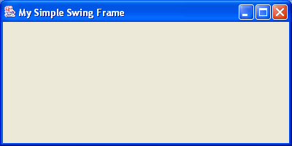
Setting Up a Top-Level Container
Swing applications have at least one top-level Swing container
JFrame, JDialog, or JApplet
The sample application has a single JFrame
// Create the Jframe.
JFrame frame = new JFrame("My Simple Swing Frame");
// Set the size of the frame (width, height).
frame.setSize(400,200);
// Ensure the window is closed properly on exit.
frame.setDefaultCloseOperation(JFrame.EXIT_ON_CLOSE);
// Make the frame visible.
frame.setVisible(true);

Slide 11
Setting Up Components
Swing defines a gamut of component classes
JLabel, JTextField, JButton, JTextArea, etc.
Components are typically contained in a JPanel
JLabel label = new JLabel("Enter text:");
JTextField textField = new JTextField(20);
JButton button = new JButton("Click me");
// Create the JPanel.
JPanel pane = new JPanel();
// Set an internal border (top, bottom, left, right) for the JPanel.
pane.setBorder(BorderFactory.createEmptyBorder(20, 20, 20, 20));
// Add components to the JPanel.
pane.add(label);
pane.add(textField);
pane.add(button);

Slide 12
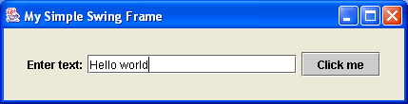
Adding Components to the Frame
Add the JPanel to the JFrame's content pane
Call pack() instead of setSize() on the JFrame
// Code, as before…
// Add the JPanel to the frame, and then display the JFrame.
frame.getContentPane().add(pane);
frame.setVisible();

Slide 13
Handling Events
Use the familiar approach to event-handling
Implement the appropriate XxxxListener interface
Implement the methods declared in the XxxxListener interface
Call addXxxxListener() on the source object
For example, to handle button click events:
import java.awt.event.ActionListener;
import java.awt.event.ActionEvent;
…
public class SimpleSwingDemo implements ActionListener {
public SimpleSwingDemo() {
…
button.addActionListener(this);
}
public void actionPerformed(ActionEvent evt) {
// Event handler code…
}
}

Slide 14
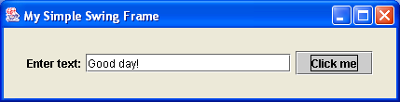
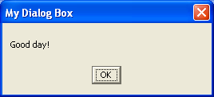
Displaying Dialog Boxes
Swing provides several ways to display dialog boxes
Use JOptionPane to create simple, standard dialogs
Use JFileChooser to display a file-chooser dialog
Use JColorChooser to display a colour-chooser dialog
Use ProgressMonitor to display a progress-indicator dialog
Use JDialog to display custom dialog boxes
For example, to display a simple dialog box:
public void actionPerformed(ActionEvent evt) {
JOptionPane.showMessageDialog(frame,
textField.getText(),
"My Dialog Box",
JOptionPane.PLAIN_MESSAGE);
}

Slide 15
Summary
Introduction to Swing
A worked example

